Slide 1
FitAI - Smart Health & Diet Companion
Subtitle: 100% Offline, Privacy-First AI Health Coach
Category: SDG 3: Good Health and Well-being
Intern Details: Rajat Kumar Haresh Prasad | Internship ID: IBMUEML012394 | Vidhyadeep University, Surat

Slide 2
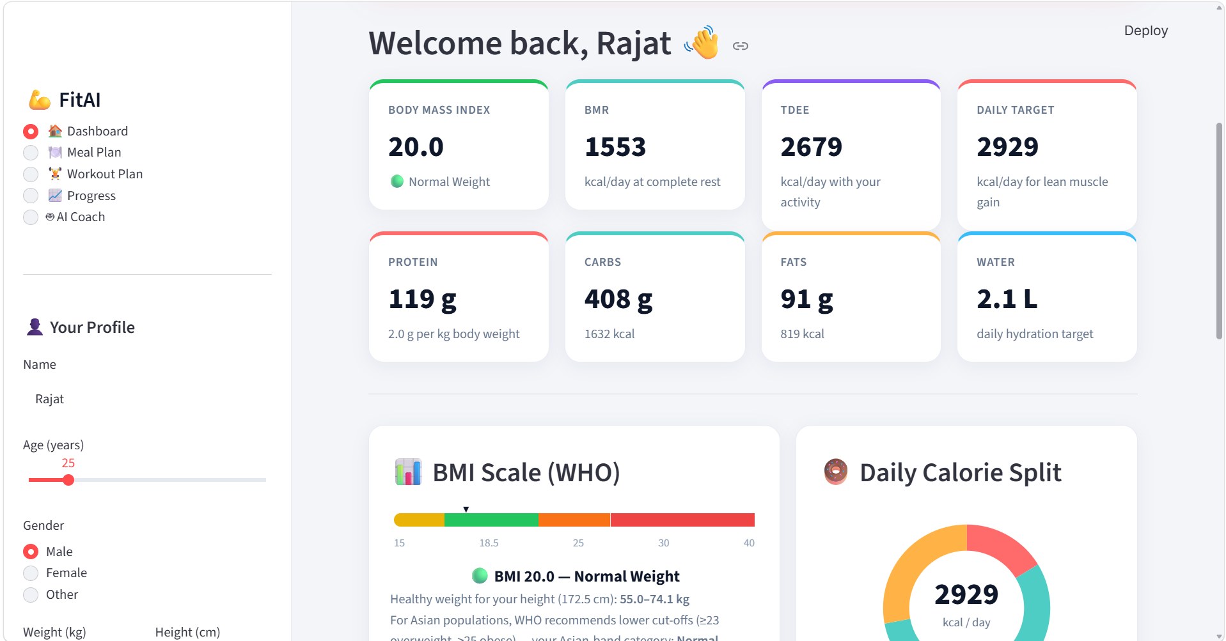
High cost of personal fitness trainers and dietitians for students.
Privacy concerns with cloud-based apps uploading biometric data.
Lack of customized, easy-to-follow meal and exercise plans.
The Problem

Slide 3
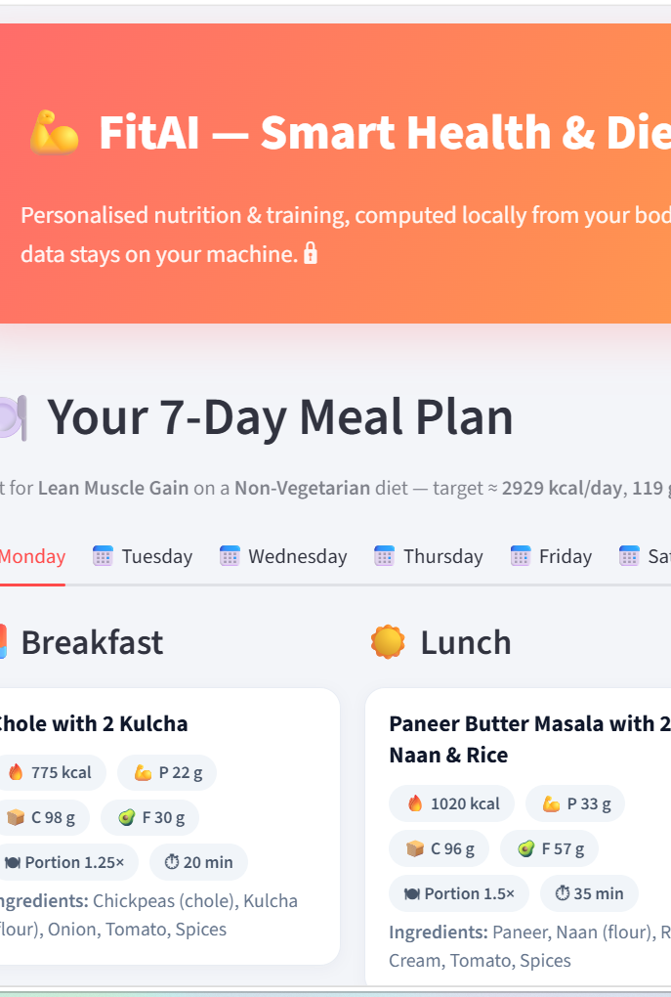
Our AI Solution
Built using Python & Streamlit; runs 100% locally with zero cloud data leaks.
Calculates exact BMI, BMR, and caloric needs using scientific equations.
Generates customized 7-day meal plans (regional foods) and workout blueprints.

Slide 4
Social Impact & SDG Alignment
Directly supports SDG 3: Good Health & Well-being.
Zero server cost—making health tracking accessible to all students and professionals.
Promotes preventive health and fitness habits.

Slide 5
Conclusion & Future Scope
Successfully delivers a privacy-focused offline health assistant.
Future Scope: Adding webcam posture tracking via Computer Vision and local LLM integration.

Slide 6
THANK YOU
Special Thanks to IBM SkillsBuild, AICTE, and BharatCares for providing this valuable learning opportunity and mentorship during the virtual internship.

